Slide 1
2D Procedural Map Generation in Unity Using BSP
By: Paul Stanek, CIS-277, Spring 2018

Slide 2
Overview
Project Description
Why Unity?
BSP Process Walkthrough
Application Features
Sample Maps
Notes:
Tonight I’m going to be presenting a quick overview of my final project. I’ll be going over the general description of my project, what is BSP, or Binary Space Partitioning, why I chose to develop the project in Unity, the main features of my application, and finally a demonstration of some of the maps that can be generated and links to resources I found invaluable while developing this application.

Slide 3
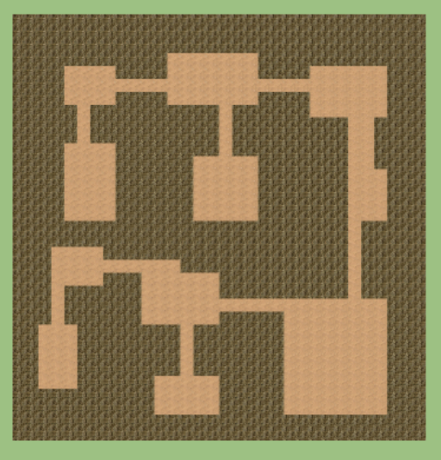
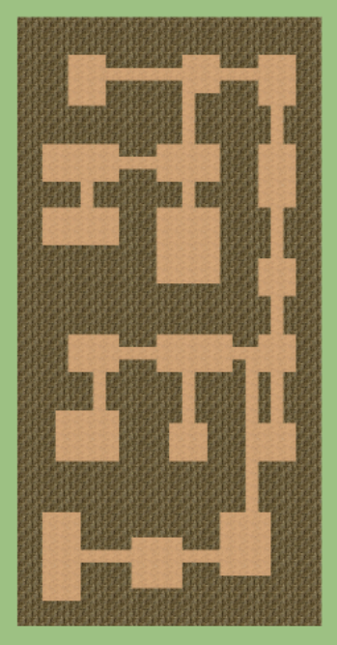
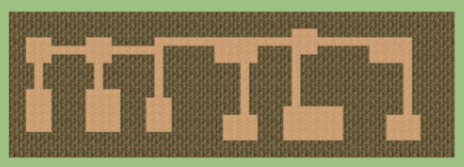
Project Description
2D Procedural Map Generation
Main Benefit – Replayability
Main Drawbacks – Can Produce Undesired Results without Significant Parameter Adjustments (rooms too large/small, isolated rooms, etc.)
Notes:
I’ve always been interested in game design, and one of the areas I hadn’t yet explored much has been procedural generation, or generating content semi-randomly. This has the benefit of increasing a game’s replayability, as no two levels or experiences are exactly alike. However, it does take a bit of time to adjust various parameters to ensure that, in this case, rooms are generated with the desired sizes, and that all rooms are connected in some way.
For this particular project, I chose to explore one method of generating semi-random 2D levels that could be used in a simple maze or roguelike game application.

Slide 4

Why Unity?
Previous exposure very limited (tutorials, etc.)
Desire to become more familiar with a commonly-used game development platform and its object hierarchy, UI elements, and overall mechanics
https://unity3d.com/
Notes:
Why Unity?
While I had experimented with creating very small programs and working through a few tutorials in Unity, I had never fully explored many if its features.
I decided to write this application in Unity to become more familiar with its object structures, hierarchies, UI elements, and overall design mechanics.

Slide 5
Binary Space Partitioning
“Root” Object
Notes:
BSP Stands for Binary Space Partitioning. It is a method of recursively subdividing a space into smaller areas, and creating a hierarchy of objects in a tree-like structure to represent all parent and child spaces. The data structure itself is commonly known as a BSP tree.
The first step in this project’s implementation of BSP involves generating the Root object which represents the entire map.

Slide 6
Binary Space Partitioning
“Root” Object
“Leaf” Objects
Notes:
Next, the root object is subdivided semi-randomly either horizontally or vertically, “leaf” objects are created, and the relationships to their parent object is stored.

Slide 7
Binary Space Partitioning
“Root” Object
“Leaf” Objects
Notes:
This subdivision continues recursively on each “Leaf” object, until the desired minimum-sized spaces are generated.

Slide 8
Binary Space Partitioning
“Root” Object
“Leaf” Objects
Continue Until Desired Size Achieved
Notes:
(Pause)

Slide 9
Binary Space Partitioning
Random Room Generation
Notes:
Next, a randomly-sized room is generated within each resulting bottom-tier leaf.

Slide 10
Binary Space Partitioning
Random Room Generation
Notes:
(Pause)

Slide 11
Binary Space Partitioning
Hallway Generation
Notes:
Finally, hallways are generated connecting the bottom-tier leaves based on their relationships in the BSP tree. This ensures that all rooms are connected in some way.

Slide 12
Binary Space Partitioning
Hallway Generation
Notes:
(Pause)

Slide 13
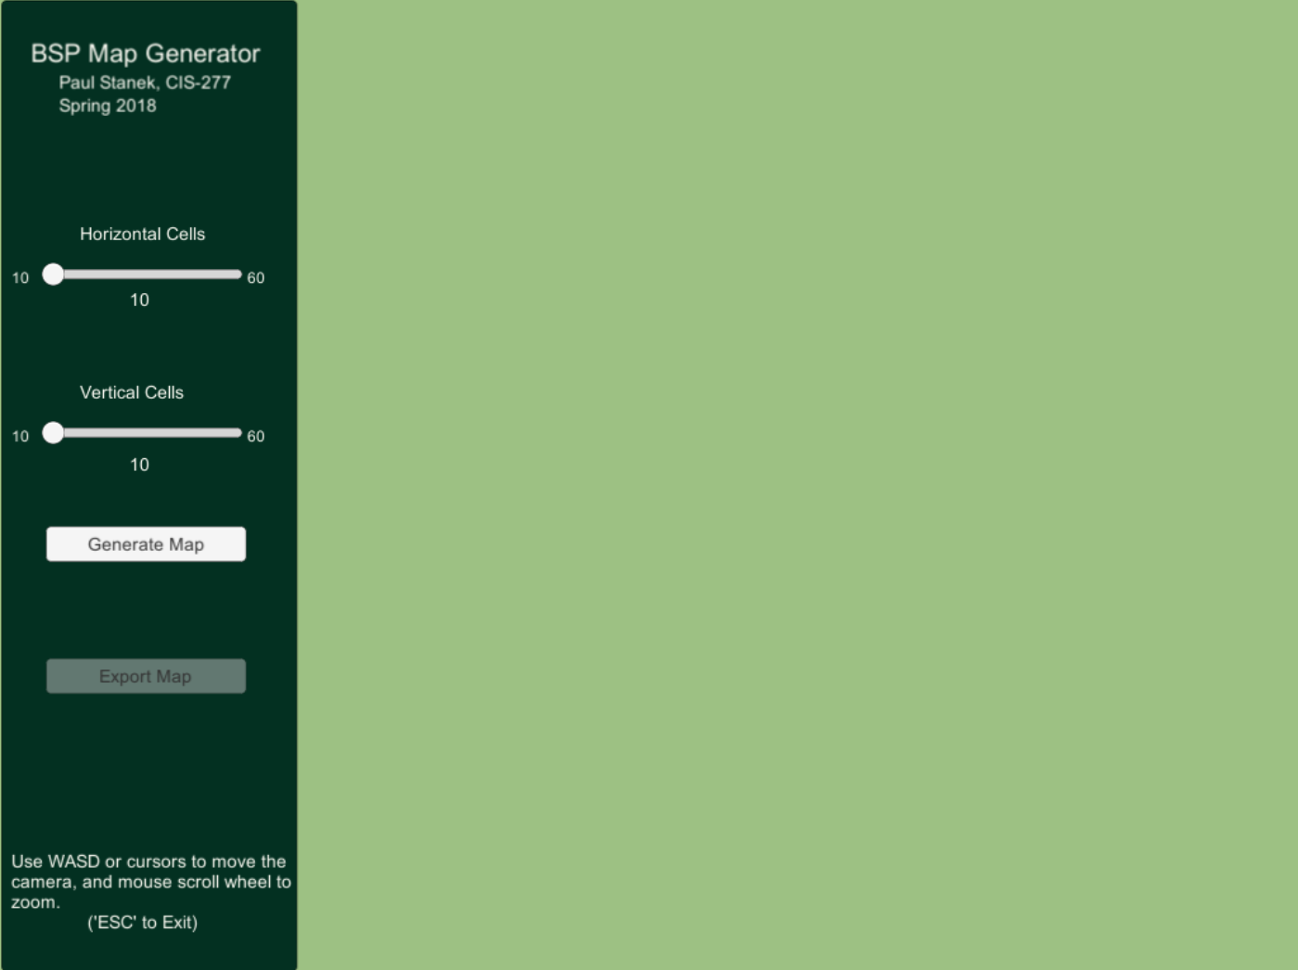
Application Features
Choose Map Size
Generate Map
Notes:
In my application, I allow the user to choose the desired size (from 10 to 60 tiles on each axis) before generating the map.

Slide 14
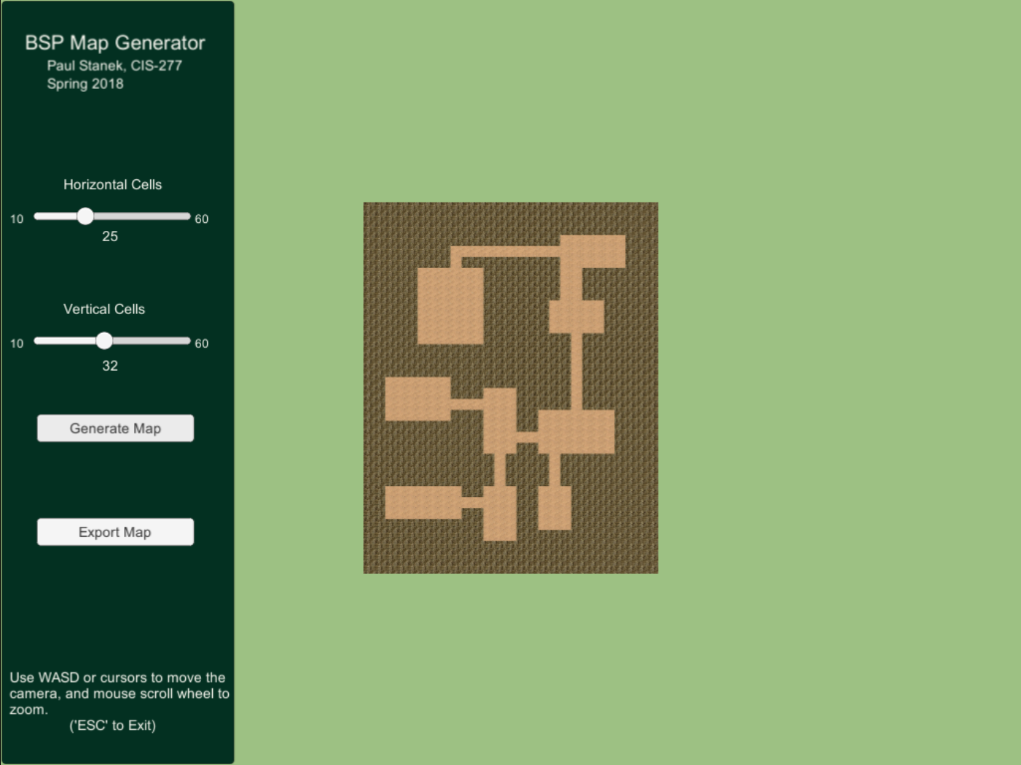
Application Features
Camera controlled by WASD keys and mouse scroll wheel
Notes:
Initially the displayed map’s scale and positioning are determined based on the chosen dimensions. I also included camera controls to allow the user to adjust the map position and to zoom in and out if desired.

Slide 15
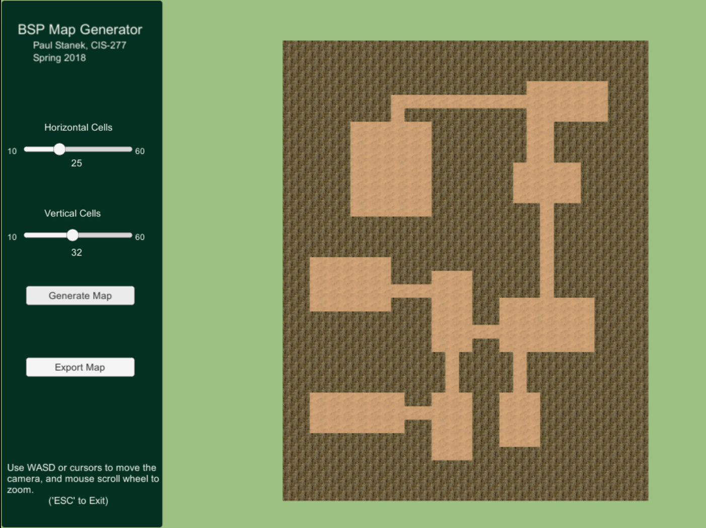
Application Features
Camera controlled by WASD keys and mouse scroll wheel
Notes:
(Pause)

Slide 16
Application Features
Export to Text File
Notes:
The user may then export the map to a simple text file for use in other applications.

Slide 17

Application Features
Filename (Based on Timestamp)
Notes:
(Pause)

Slide 18
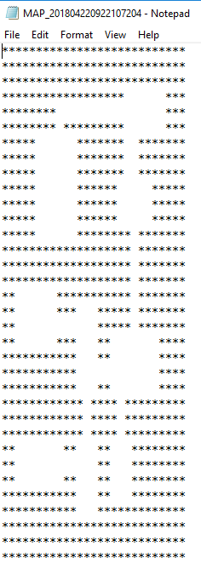
Application Features
Notes:
(Pause)

Slide 19
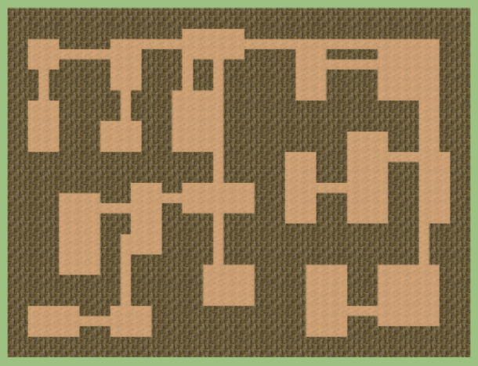
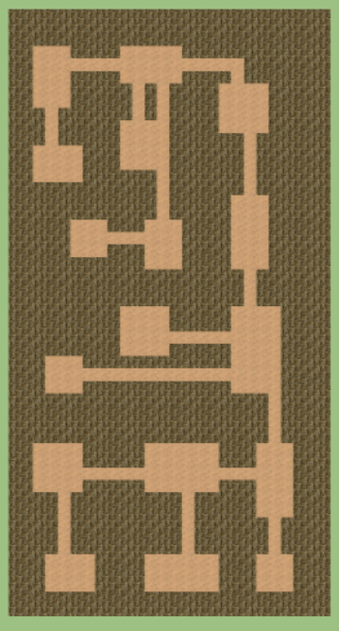
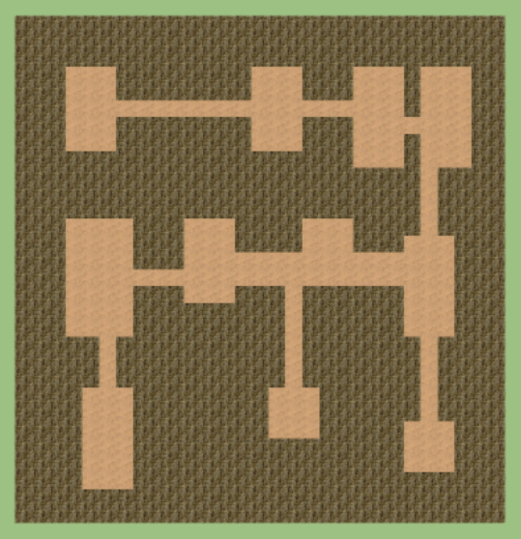
Sample Maps
Notes:
Here are a few sample maps generated by the application.

Slide 20
Resources
The following tutorials and resources were invaluable in creating this project, and I highly recommend reading them if you are interesting in this type of random map generation:
How to Use BSP Trees to Generate Game Maps (by Timothy Hely):
https://gamedevelopment.tutsplus.com/tutorials/how-to-use-bsp-trees-to-generate-game-maps--gamedev-12268
Binary Trees (by Richard Fleming, Jr):
https://www.youtube.com/watch?v=S5y3ES4Rvkk
Basic BSP Dungeon Generation (RogueBasin):
http://www.roguebasin.com/index.php?title=Basic_BSP_Dungeon_generation
Notes:
Finally, here are links to some resources if you are interested in BSP and its application in procedural map generation.
Thank you for your time.

Slide 21
Notes:
Finally, here are links to some resources if you are interested in BSP and its application in procedural map generation.
Thank you for your time.

